Slide 1
Event Report Classification
Jesse Robles

Slide 2
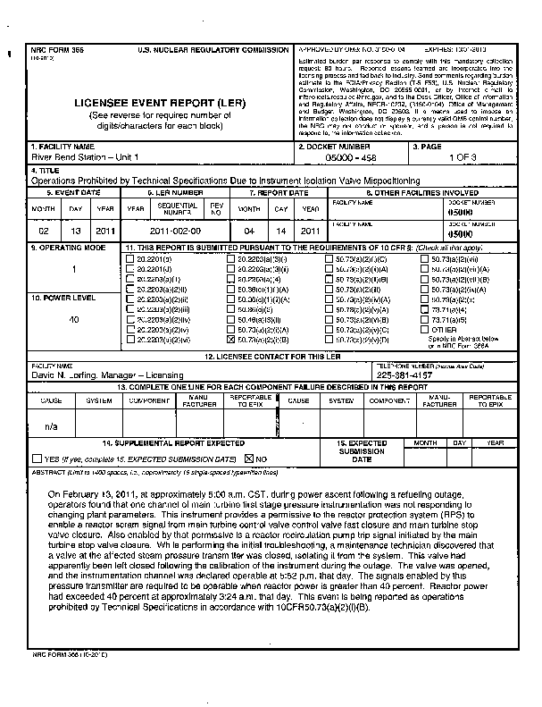
Background
Submitted event reports are manually classified into ~16 categories to send to reviewers
Objective is to build a model to classify documents into these categories to ensure they are reviewed by appropriate individuals
Obtaining the documents (pdfs) and extracting the text was the most time-consuming task

Slide 3
Models
This is a multilabel problem, but I considered each class a binary classification problem (although there are imbalanced classes)
Build pipelines with:
Tf-Idf tuned for stop words (None, english), norm (None, L1, L2), and n-gram range ((1, 1) – (1, 4))
Support Vector Classifier with linear kernel
Same as LinearSVC but with probabilities
Tuned for penalty parameter (C) of the error term
OR
Multinomial Naïve Bayes
Tuned for smoothing parameter (alpha)
Added additional features (title, keyword presence) using feature union class

Slide 4
Evaluation Metrics
Tuned hyper-parameters using area under the ROC curve (AUC)
Inspected the confusion matrix for each model
Focused on balancing false negatives with false positives
For business objective, prefer false positive to ensure nothing gets missed

Slide 5
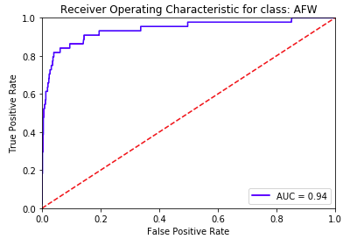

Results

Slide 6
Possible Improvements
Add additional features
Text of entire report
Facility that submitted the report
Regulation report submitted under
Corpus specific synonyms
Replace synonyms (hack)
Use semantic similarity (spaCy)

